Slide 1

When a client changes a specification, how many repetitive updates do you make?
LESS ADMIN · MORE DESIGN TIME · BETTER PROJECT MARGINS
Net Atelier keeps the project specification, budget, and draft documents connected. Change the specification once; the budget and draft proposal, supplier order, and invoice reflect the change.
Fewer stale prices. Fewer wrong-item errors. Less admin—and more time to design.
01 / 08
Notes:
Open with the question. Invite the audience to count the places a typical specification change appears today. Position Net Atelier as the connected project record, not another board tool.

Slide 2
From product discovery to invoice, one connected project.
ONE PRODUCT · ONE SOURCE OF TRUTH
Save a product once. It stays linked to the client board, budget, proposal, supplier order, and invoice drafts, so every stage starts with current product information.
01
02
03
04
05
06
Find
Present
Budget
Propose
Order
Invoice
Save product and
supplier details
Show it on the
client board
Add its cost to the
project budget
Send products and
prices for review
Prepare the supplier
order
Prepare the client
invoice
02 / 08
Notes:
Use this as the map for the walkthrough. The six stages are deliberately simple: Find, Specify, Price, Approve, Deliver, Review. Mention that the same project record connects each step.

Slide 3

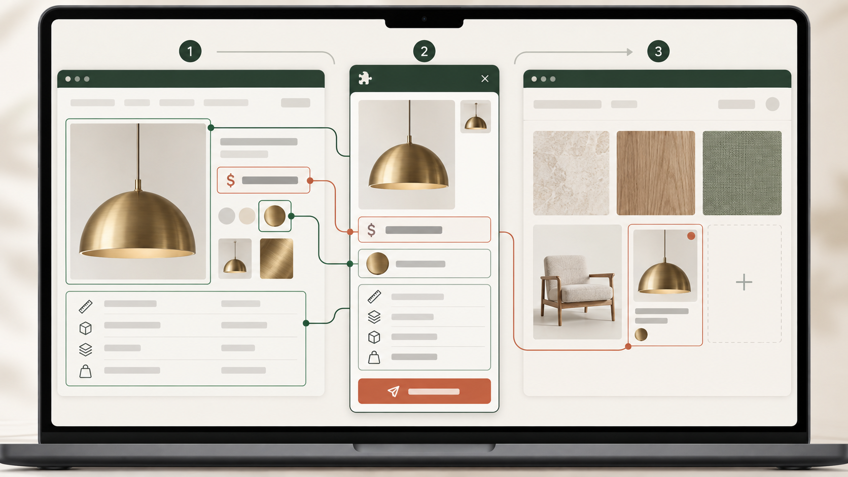
From a supplier website to your board, budget, and documents.
SOURCE FASTER · STOP RETYPING
PRODUCT PICKER
See a product on a supplier or other website? Use the AI Product Picker web browser extension to send it straight to your Net Atelier project board, with its image and available product details.
That product populates the project budget. The same current details then feed the proposal, supplier order, and invoice drafts.
Available product details are added to the project record.
03 / 08
Notes:
Demonstrate Product Picker on a supplier page. Emphasize the available listed details are captured into a usable record, reducing re-keying and image shuffling.

Slide 4

Make the client board part of the working project.
PRESENT CLEARLY · BUDGET ACCURATELY
DESIGN SELECTIONS
Put saved products on the client board. Each product keeps its image, category, full specification, supplier or manufacturer details, cost, markup, margin, and other project information. The board is not just a set of images: it is part of the working project.
Already have a board in PowerPoint or Canva? Bring it in, then connect the products you want to manage in the project.
Present choices clearly. Keep product specifications, commercial details, and budget connections with every board item.
04 / 08
Notes:
Show an existing board import if helpful, then create or open a Net Atelier board. Make clear that the board item includes its image, category, full specification, supplier or manufacturer details, cost, markup, margin, and other project information. The board is part of the working project, not just a visual presentation.

Slide 5
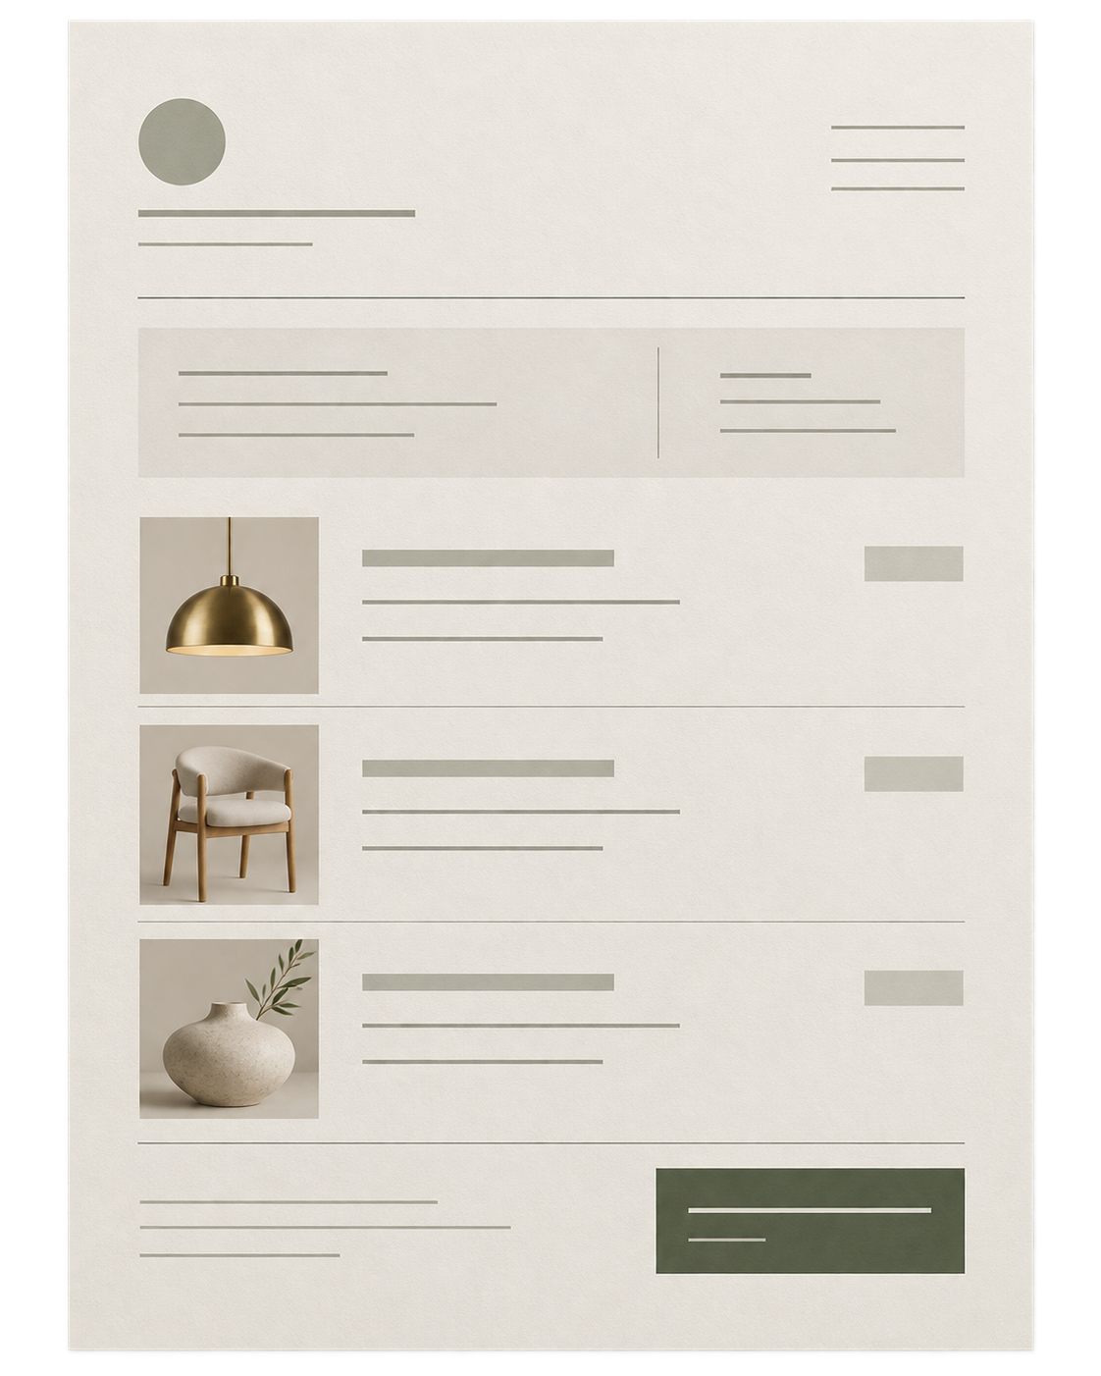
Send a proposal the client can review and respond to.
CLEAR CLIENT CHOICES · LESS EMAIL BACK-AND-FORTH
PROPOSAL
Create the proposal from the products and planned costs already in the project. The client sees the selected products and prices together, rather than across separate emails and lists.
If the client asks to change a product, update it once, then review the revised draft before you send it.
Selected products and planned prices are reviewed in the project before the draft is sent.
05 / 08
Notes:
Frame the client view as a single clear decision surface. The approval belongs alongside the selection, so the next commercial document starts from the approved choice.

Slide 6
Make one change—not four separate corrections.
ONE CHANGE · FEWER COSTLY ERRORS
When a client changes a specification, update it once in Net Atelier. The budget and linked draft proposal, supplier order, and invoice use the revised details.
Proposal
Specification
Purchase order
Invoice
Products, prices, and choices for the client
Product details your team works from
Products and details for the supplier
The amount you charge the client
1. Update the changed specification in Net Atelier →
2. Check the revised budget, then review the updated draft before you send it.
06 / 08
Notes:
Show the draft documents created from the project. Be precise: changes update linked project records and affected draft documents; final issued documents should be reviewed through the normal workflow.

Slide 7
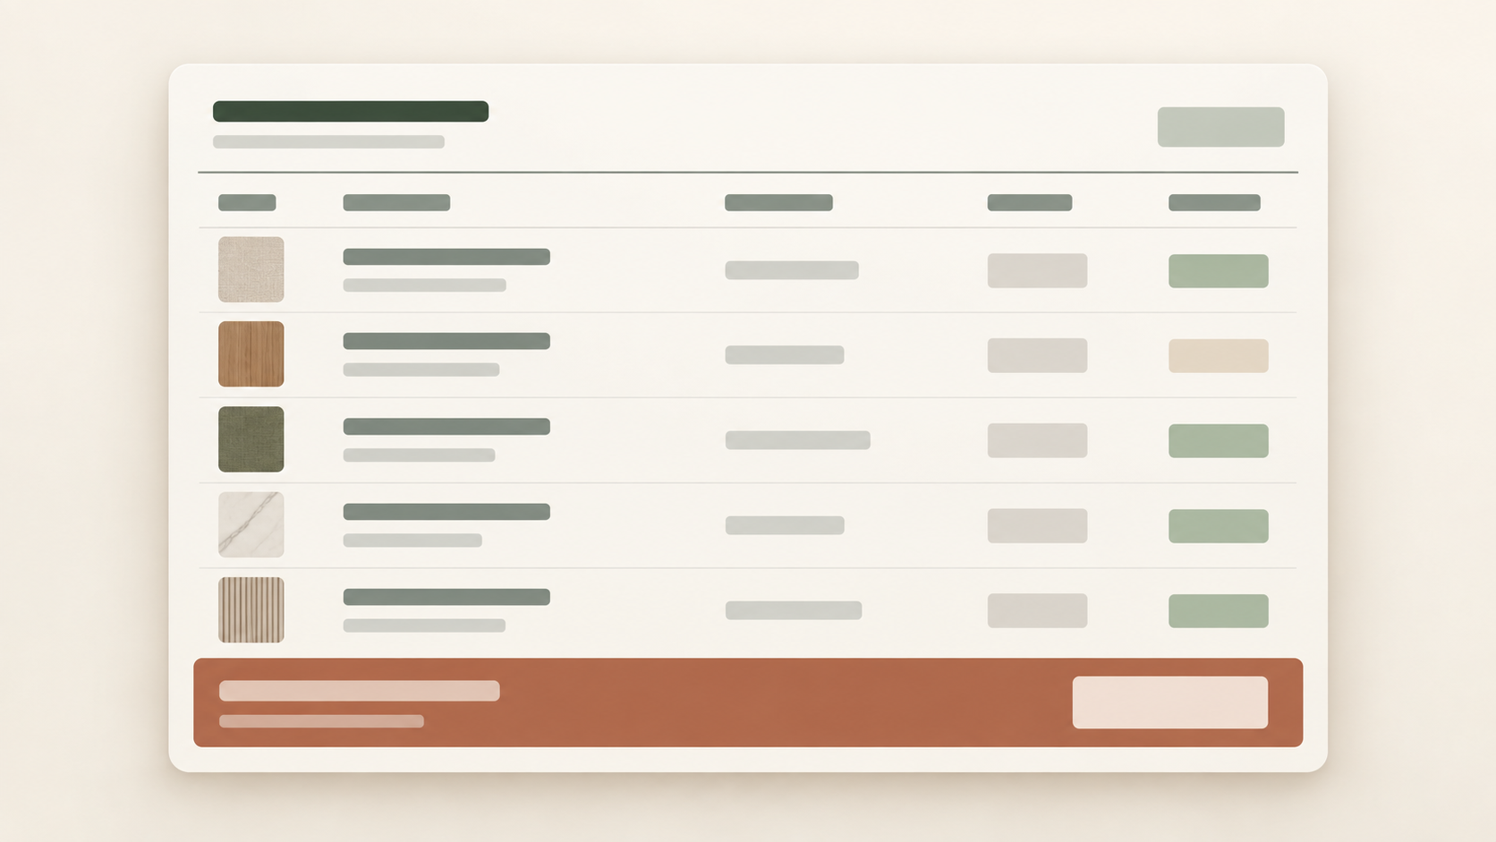
Protect your margin.
CURRENT PROJECT COSTS · PROTECT YOUR MARGIN
MASTER BUDGET
Compare the budget with what you have spent
For each category, see the planned cost beside the amount spent. Spot a growing overage before the next supplier order eats into your margin.
Check the total project budget
See the planned total and amount spent for the whole project without rebuilding the totals in another spreadsheet.
Download the budget as an Excel file
Export the project budget when you need to analyse it, share it, or work with it outside Net Atelier.
07 / 08
Notes:
Open the financial view. Explain that planned and actual spend can be reviewed by category before the next decision. Mention that project data can also be exported to Excel.

Slide 8
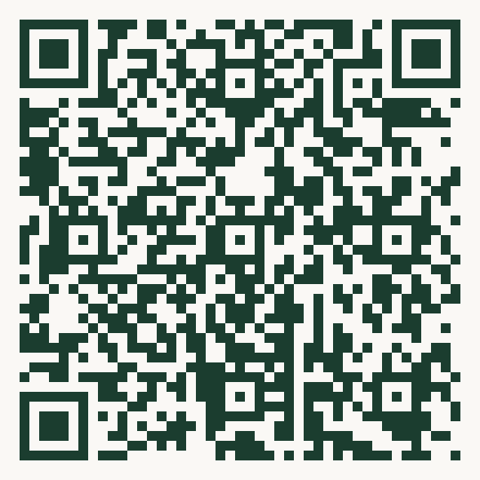
Spend more time designing. Less time rebuilding project documents.
START WITH ONE LIVE PROJECT
Start a 14-day free trial. A card is required, and you can cancel at any time.
$49 per month for one user. Add users for $9 per user, per month.
Scan to start your trial
net-atelier.com/primavera
14-day trial · cancel anytime
Save products from supplier websites · Keep boards, budgets, and drafts in sync ·
Avoid retyping a client change across documents · Export the project budget to Excel.
14-day free trial · card required · cancel anytime
08 / 08
Notes:
Close with a clear invitation: scan the code to start a 14-day trial. A card is required and the trial can be cancelled anytime. Pricing is $49 per month for one user, plus $9 per additional user.

